Slide 1
Plans for GOES-17 GLM in NWS
NWS/OBS Update to GOES-17 GLM Provisional PS-PVR
December 3, 2018

Slide 2
Overall Summary
NWS has not yet evaluated the GOES-17 GLM data
GOES-17 focus to date has been on establishment and evaluation of GOES-17 KPP/ABI flows
As first step, NWS plans to follow GOES-16 Flash Extent Density (FED) implementation paradigm (see slide 5)
What? GOES-17-based CONUS grid of 1-min and 5-min FEDs (like GOES-16 FED)
How? Generated from GRB stream at AWC; distributed terrestrially to CONUS AWIPS systems
When? Development and implementation (first for limited evaluation) underway during December 2018; evaluation followed by broader roll-out to NWS field sites in January 2019
NWS’ Plans for GOES-17 GLM, Beyond FED
OCONUS version(s) and additional GLM parameters (beyond FED) to follow
Migration of NWS’ GLM processing from AWC to IDP and then to NESDIS
Fuller infusion of GLM into NWS systems/operations
Notes:
High quality retrieval flag

Slide 3
NWS GLM Implementation Team
Infusion of GLM into NWS is an ongoing collaboration including these key participants:
NESDIS/STAR, GLM Working Group Lead (Scott Rudlosky)
OAR/NSSL Hazardous Weather Testbed (Kristin Calhoun, Tiffany Meyer)
Texas Tech (Eric Bruning)
NASA SPoRT (Geoffrey Stano, Kevin McGrath)
NWS/NCEP Aviation Weather Center (Josh Scheck, Amanda Terborg)
NWS Office of Science & Technology Integration, Operations Proving Ground (Matt Foster, Chad Gravelle, Jack Richardson, Kim Runk)
NWS Office of Observations (Brian Gockel, Joe Zajic, Lee Byerle, Eric Guillot)
NWS Office of Central Processing, AWIPS Program Office (Steve Schotz, Scott Jacobs, Kevin Conaty, Ana Rivera)
NWS Analyze Forecast and Support Office (Greg Schoor)
Team carried out G16/GLM conceptual and software development, test/eval of first products, documentation/training leading to full deployment (team attention now turning to G17 GLM)

Slide 4
Currently Fielded GLM Products in AWIPS (GOES-16 only)
The current GOES-16 GLM product available across the majority of NWS sites:
GOES-16 Flash Extent Density (FED) Grid over the CONUS
Derived from GLM L2 (from NWS GRB antenna downlink)
One- and five-minute grids, both updated/distributed every minute containing the most-recent one- or five-minute summation
Fielded AWIPS baseline GOES-R plugin handles ingest and display of gridded GLM products
NWS CONUS-wide* roll-out of FED occurred Summer 2018
Uses non-baseline distribution path (more detail in upcoming slides)
Approx. 21 NWS field sites participating in an extended eval of G16 GLM parms since June 2018, including four additional GLM parameters:
One- and five-minute average flash area
One- and five-minute total optical energy
This will be extended to G17-based parameters starting in January 2019.
* NWS CONUS field slides receiving GLM FED include Weather Forecast Offices (WFOs) and most River Forecast Centers (RFCs)

Slide 5
GOES-16 GLM NWS Rollout (Pathfinder for GOES-17)
Final stages of GLM FED development and Summer 2018 roll-out informed by:
Beta site (~12 NWS sites) and HWT testing events held in Spring 2018
Feedback from Extended Evaluation sites (additional ~9 sites, Jun-Jul 2018)
Functional/performance eval/testing by GLM working group at NWS OPG and labs
For AWIPS deployment, used Redhat Package Manager (RPM) configuration file, pushed out to CONUS NWS sites in June 2018
Close coordination with AWIPS/NCF, who staged the RPMs for activation at each site
Included a separate RPM for Extended Eval sites to evaluate average flash area and total optical energy
Outreach and deployment coordination: VLab, Videos, TOWR-S Chatroom/Slides
Team contacted all NWS CONUS WFOs and most RFCs, to assist and facilitate with activation/deployment which finished August 2018 (115+ confirmed users)

Slide 6
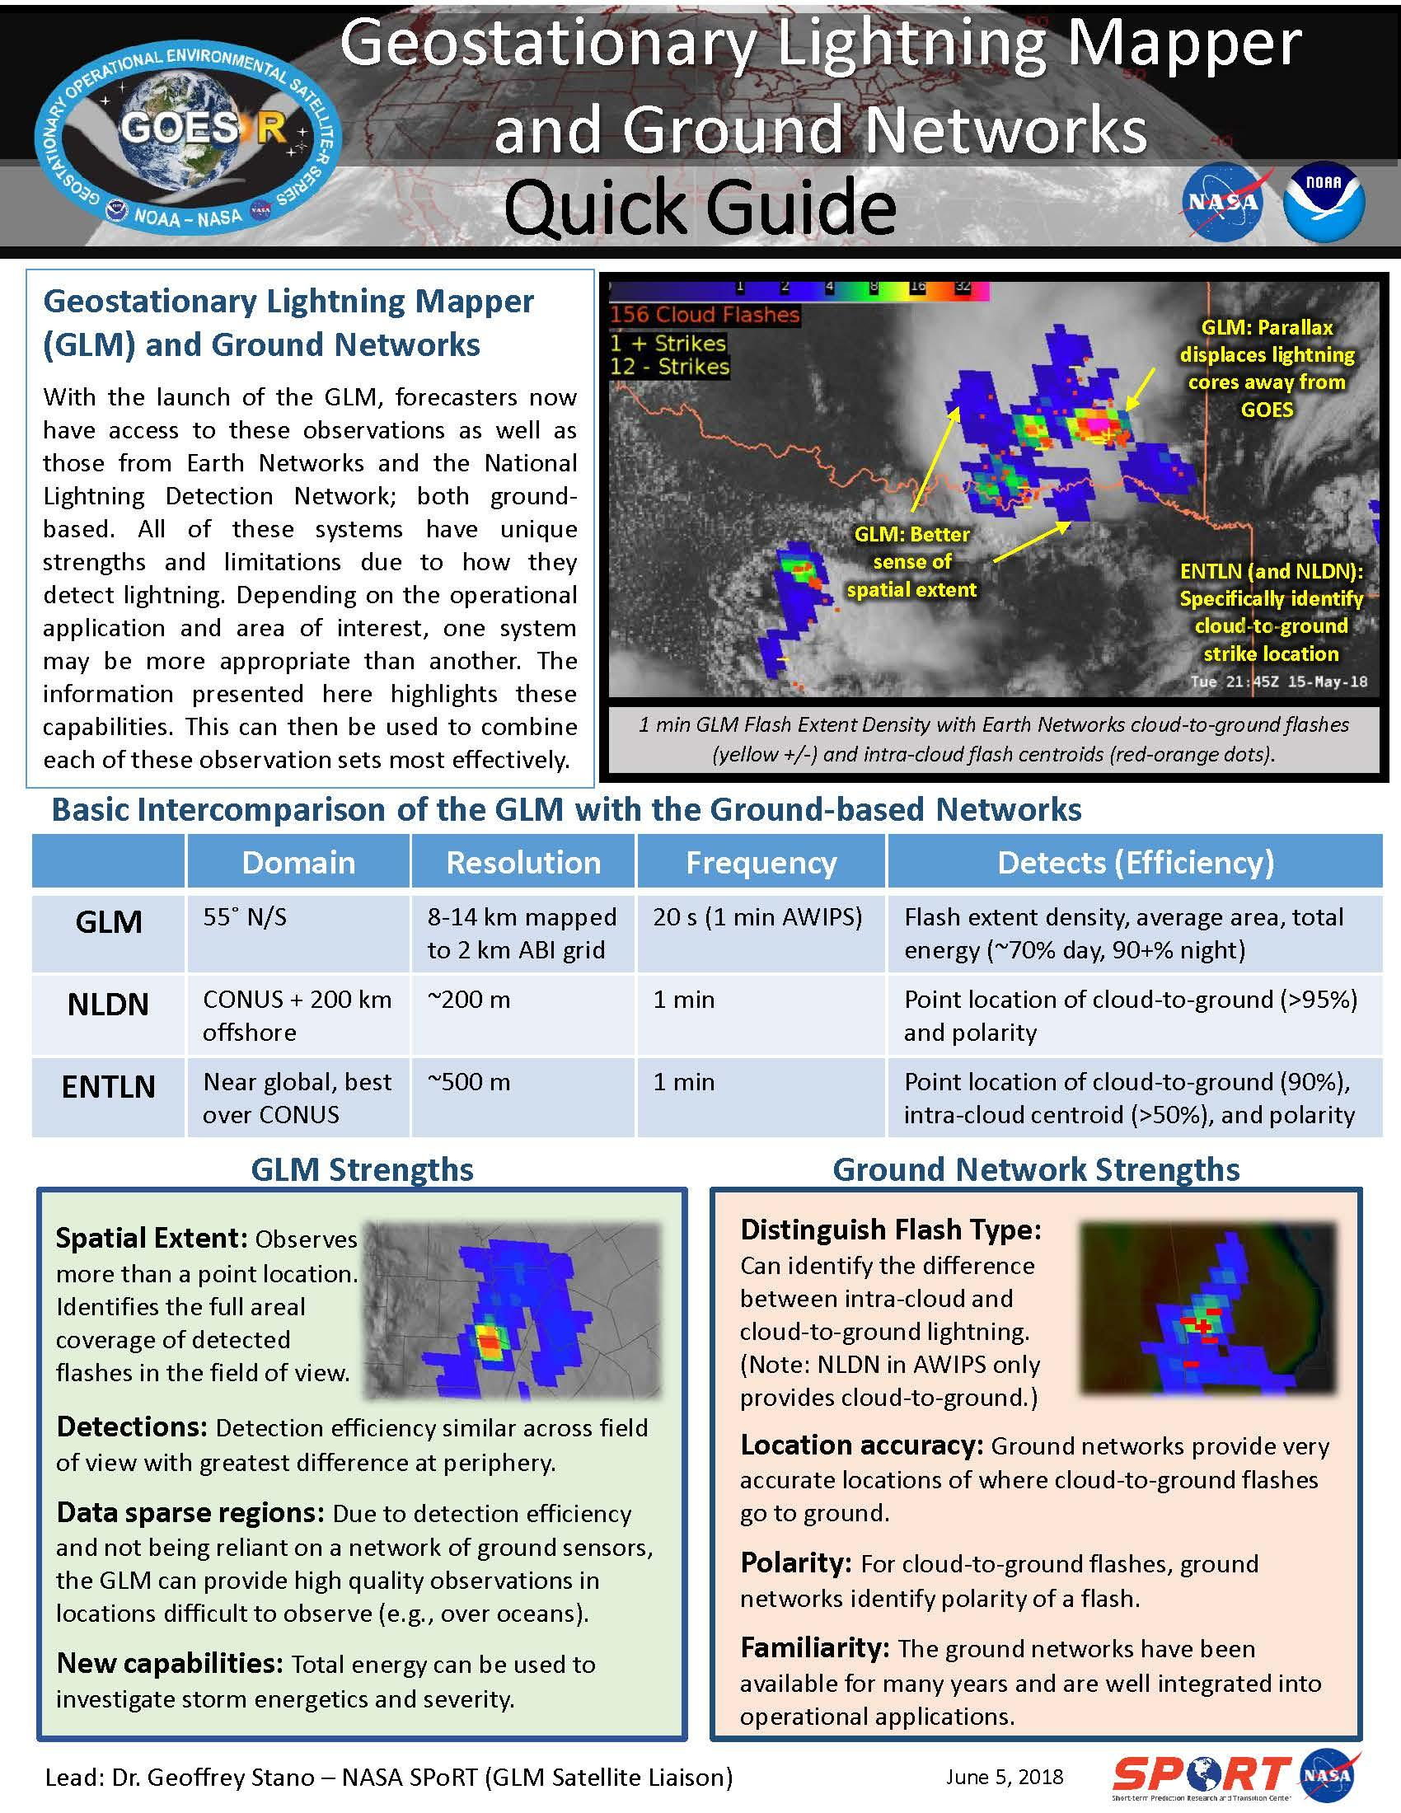
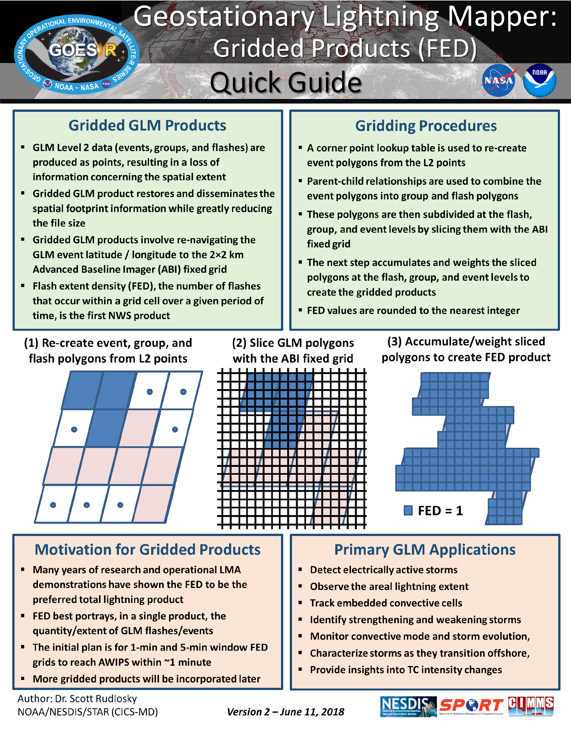
GLM Training/Orientation Materials for GOES-16
Developed six quick guides and briefs:
Definitions and Detection Methods
GLM Gridded Products
GLM Data Quality
GLM AFA and TOE
GLM Applications
GLM and Ground Based Networks
GLM Virtual Lab Webpage:
Training
Product Description
Imagery Examples
Blog and FAQ
This material will be adapted for
GOES-17 training
https://vlab.ncep.noaa.gov/documents/3553989/3558863/GLM_Quick_Guide_Gridded_Products_June_2018.pdf/c52912d7-035c-7697-3caf-21a40192f102
(Some NWS/vlab pages access controlled)

Slide 7
GOES-16 GLM FED in AWIPS/CAVE/D2D
Initial GOES-17 GLM FED implementation in AWIPS will be based on above.

Slide 8
Next Steps for GLM Implementation Across NWS (1 of 2)
Roll-out GOES-17 GLM FED and other products via similar migration path as was done for GOES-16 (planned for January 2019)
Complete migration of GOES-16/17 FED product generation and data flows to national-baseline systems
Complete assessment of “Extended Evaluation” products and begin migration/T2O of any mature GOES-16/17 products:
Average Flash Area (one- and five-min products)
Total Optical Energy (one- and five-min products)
Explore and evaluate additional GLM/derived products
30-min accumulated FED every 1-min
Flash and Centroid Density products (1 and 5-min)
Extend geographic coverage of existing NWS GLM products beyond CONUS to meet NCEP/Center and Off-CONUS requirements

Slide 9
Next Steps for GLM Implementation Across NWS (2 of 2)
Augment NWS forecaster systems (e.g., AWIPS and N-AWIPS) for current and maturing GLM products
Fuller integration of GLM products into NWS forecast/warning processes (either directly or via other derived products)
For proven GLM products, prepare SPSRB request(s) for implementation of product generation and distribution within NESDIS ground systems
Maintain bi-directional NWS/GOES-R communication as GLM products are evolved and improved
Smooth out software updates
Product additions or enhancements that warrant user awareness (and in some cases, training)

Slide 10
Thank You!
Questions/Comments?

